Slide 1
Introduction to Data Analytics
Class #1
Introduction to Data
Dr. Sreeja S R
Assistant Professor
Indian Institute of Information Technology
IIIT Sri City

Slide 2
Quote of the day..
You can have data without information,
but you cannot have information without data.

Slide 3
In today’s discussion…
Introduction to data
Current trend
Data and Big data
Big data vs. small data
Tools and techniques

Slide 4
Introduction to data
Example:
10, 25, …, Sri City, Sreeja, 10CS3002, india@gov.in
Anything else?
Data vs. Information
100.0, 0.0, 250.0, 150.0, 220.0, 300.0, 110.0
Is there any information?

Slide 5
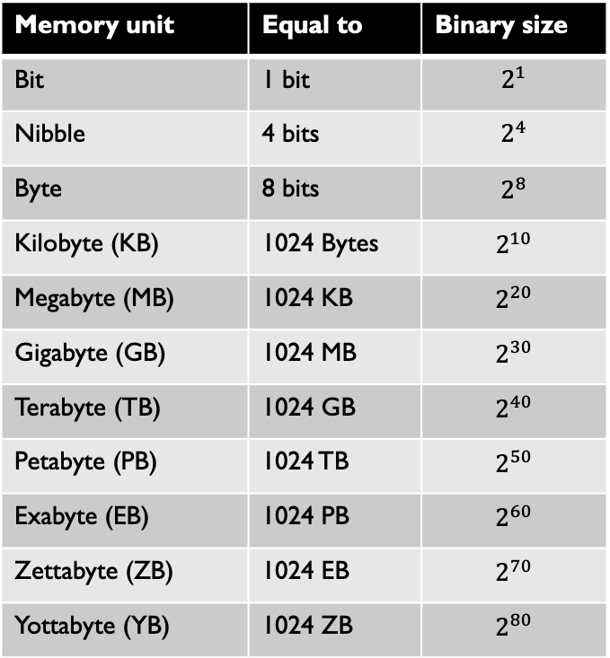
How large your data is?
What is the maximum file size you have dealt so far?
Movies/files/streaming video that you have used?
What is the maximum download speed you get?
To retrieve data stored in distant locations?
How fast your computation is?
How much time to just transfer from you, process and get result?
Memory unit | Equal to | Binary size
Bit | 1 bit | $$2^{1}$$
Nibble | 4 bits | $$2^{4}$$
Byte | 8 bits | $$2^{8}$$
Kilobyte (KB) | 1024 Bytes | $$2^{10}$$
Megabyte (MB) | 1024 KB | $$2^{20}$$
Gigabyte (GB) | 1024 MB | $$2^{30}$$
Terabyte (TB) | 1024 GB | $$2^{40}$$
Petabyte (PB) | 1024 TB | $$2^{50}$$
Exabyte (EB) | 1024 PB | $$2^{60}$$
Zettabyte (ZB) | 1024 EB | $$2^{70}$$
Yottabyte (YB) | 1024 ZB | $$2^{80}$$

Slide 6
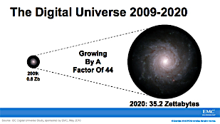
Growth of data

Slide 7
Sources of data
“Every day, we create 2.5 quintillion bytes of data
So much that 90% of the data in the world today has been created in the last two years alone.
The data come from several sources
sensors used to gather climate information
posts to social media sites,
digital pictures and videos
purchase transaction records
cell phone GPS signals
etc. …… to name a few!

Slide 8
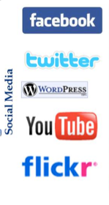
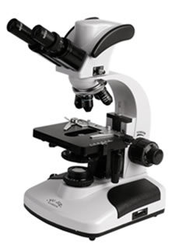
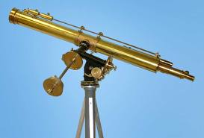
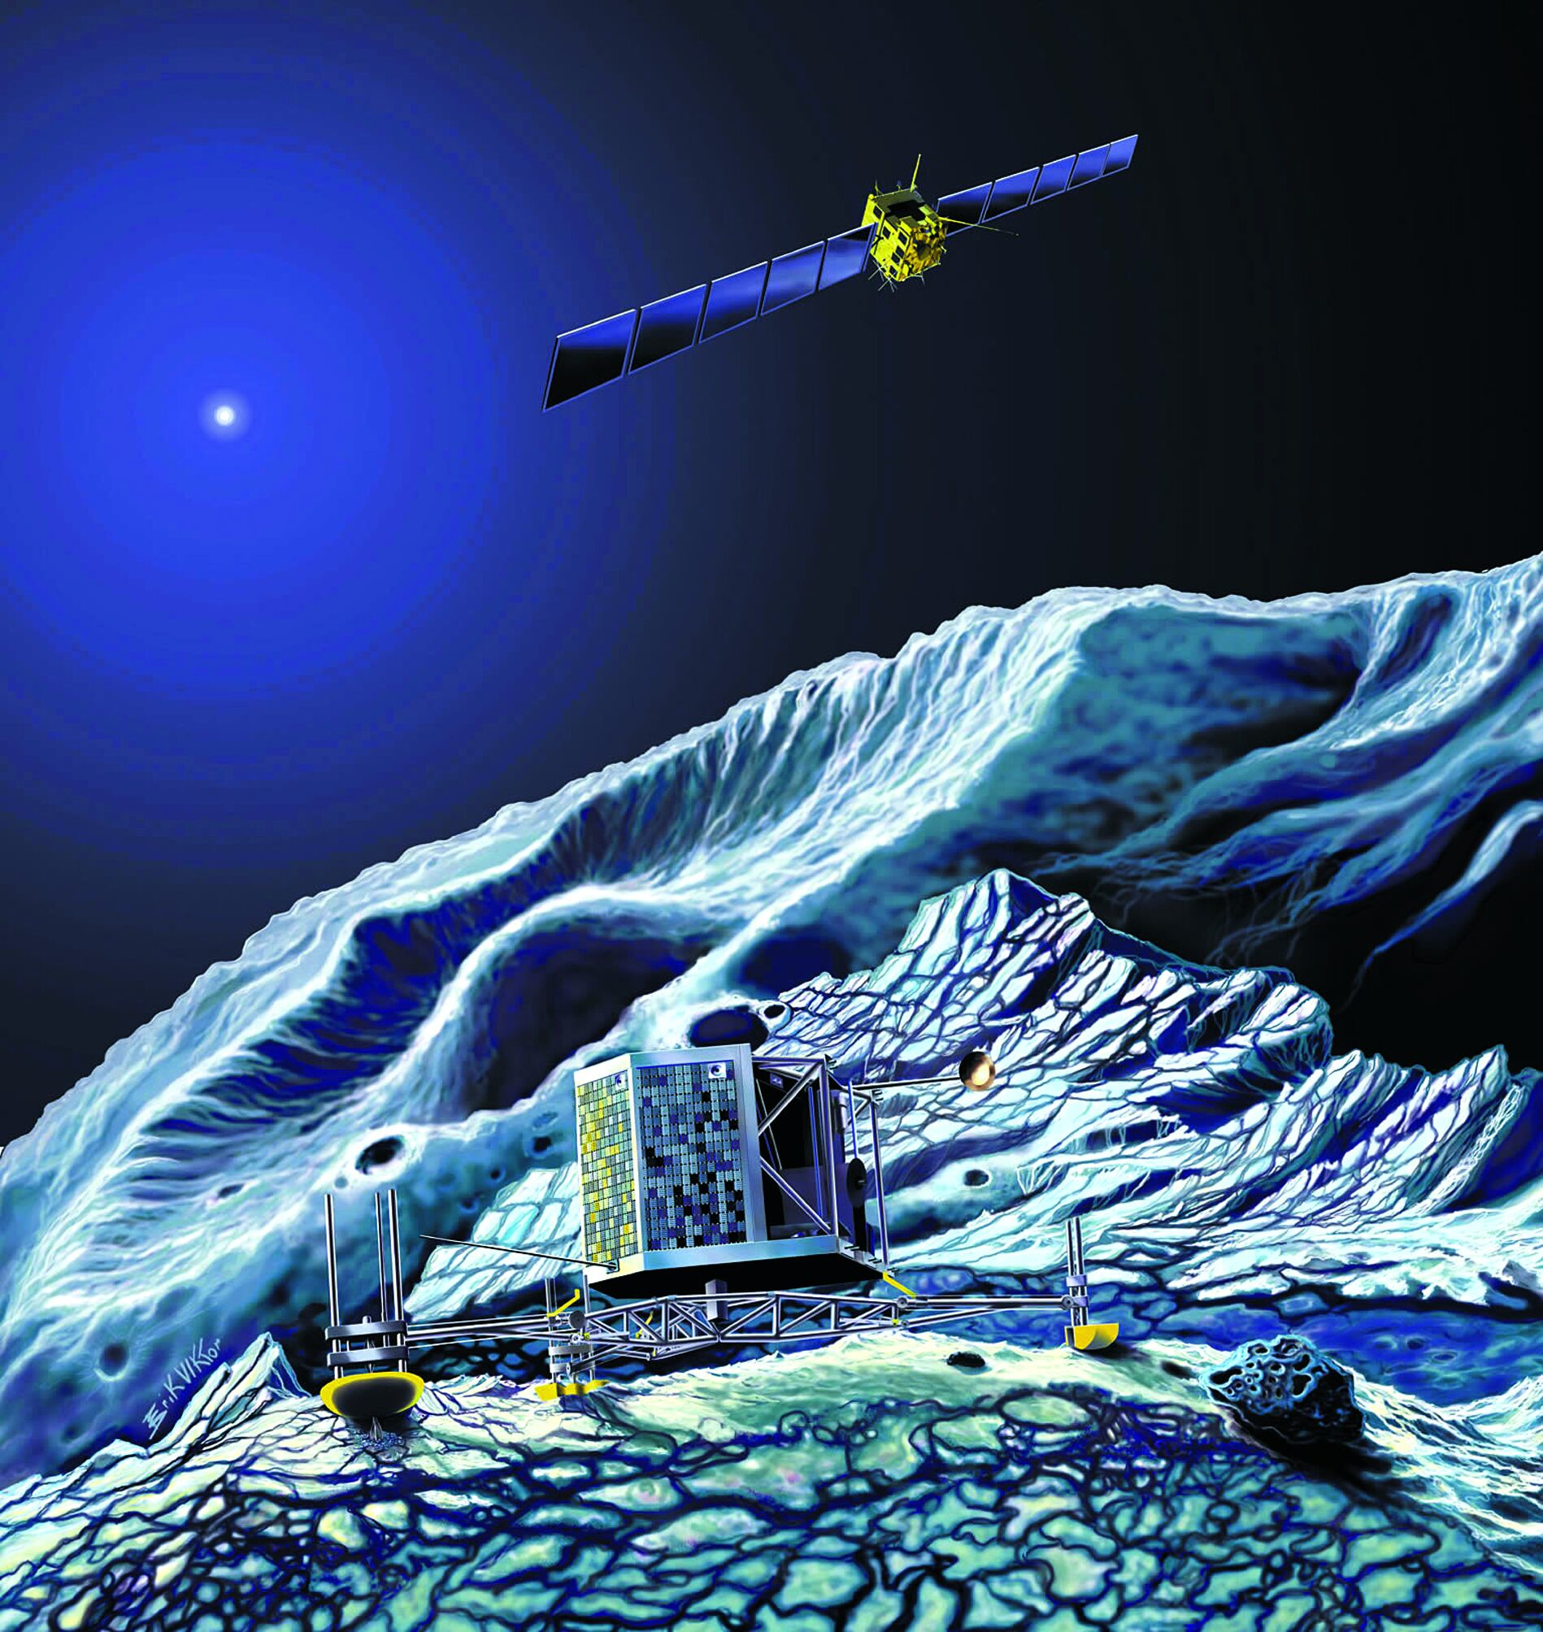
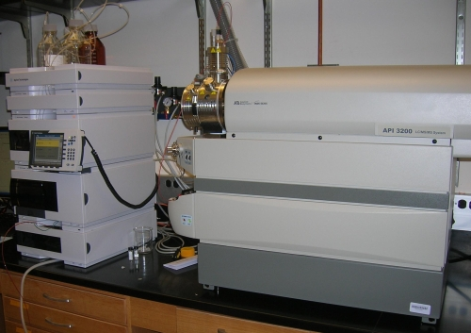
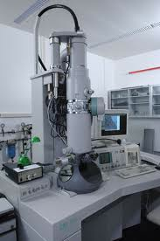

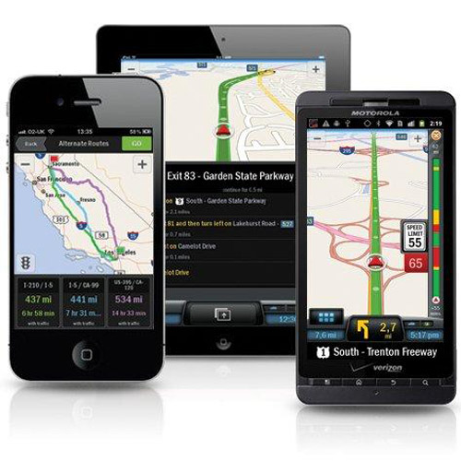
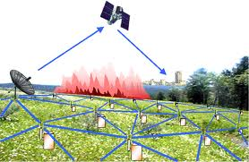
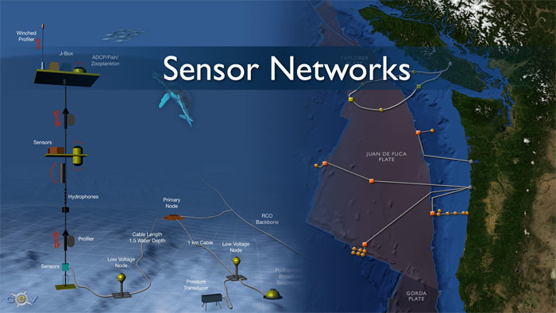
Examples
Social media and networks
(All of us are generating data)
Scientific instruments
(Collecting all sorts of data)
Sensor technology and networks
(Measuring all kinds of data)
Mobile devices
(Tracking all objects all the time)

Slide 9
Now data is Big data!
No single standard definition!
‘Big-data’ is similar to ‘Small-data’, but bigger
…but having data bigger consequently requires different approaches
techniques, tools and architectures
…to solve: new problems
…and, of course, in a better way
Big data is data whose scale, diversity, and complexity require new architecture, techniques, algorithms, and analytics to manage it and extract value and hidden knowledge from it…

Slide 10
Now data is Big data!
No single standard definition!
‘Big-data’ is similar to ‘Small-data’, but bigger
…but having data bigger consequently requires different approaches
techniques, tools and architectures
…to solve: new problems
…and, of course, in a better way
Big data is data whose scale, diversity, and complexity require new architecture, techniques, algorithms, and analytics to manage it and extract value and hidden knowledge from it…

Slide 11
Characteristics of Big data: V5
Source: Twitter

Slide 12
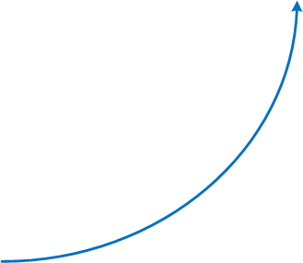
5V : V for Volume
Volume of data, which needs to be processed is increasing rapidly
More storage capacity
More computation
More tools and techniques

Slide 13
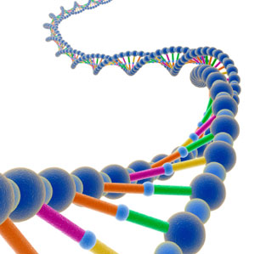
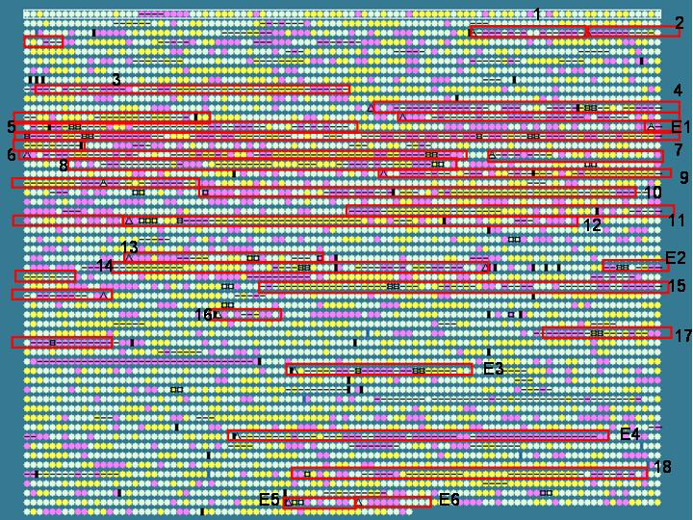
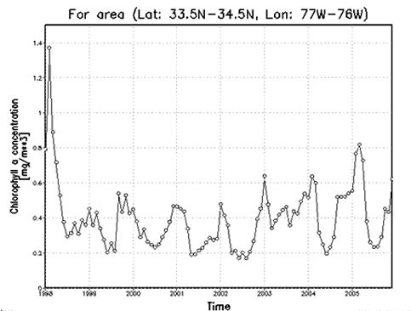
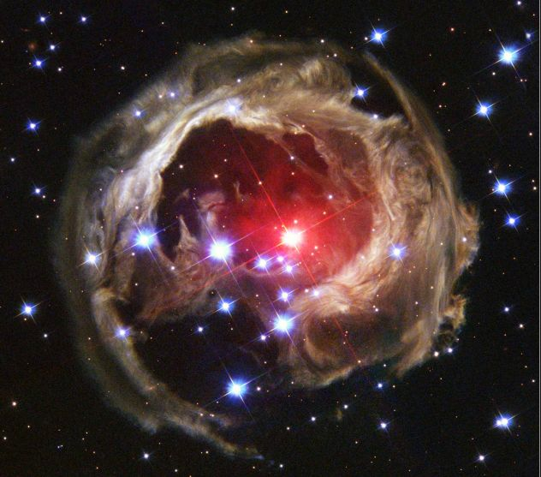

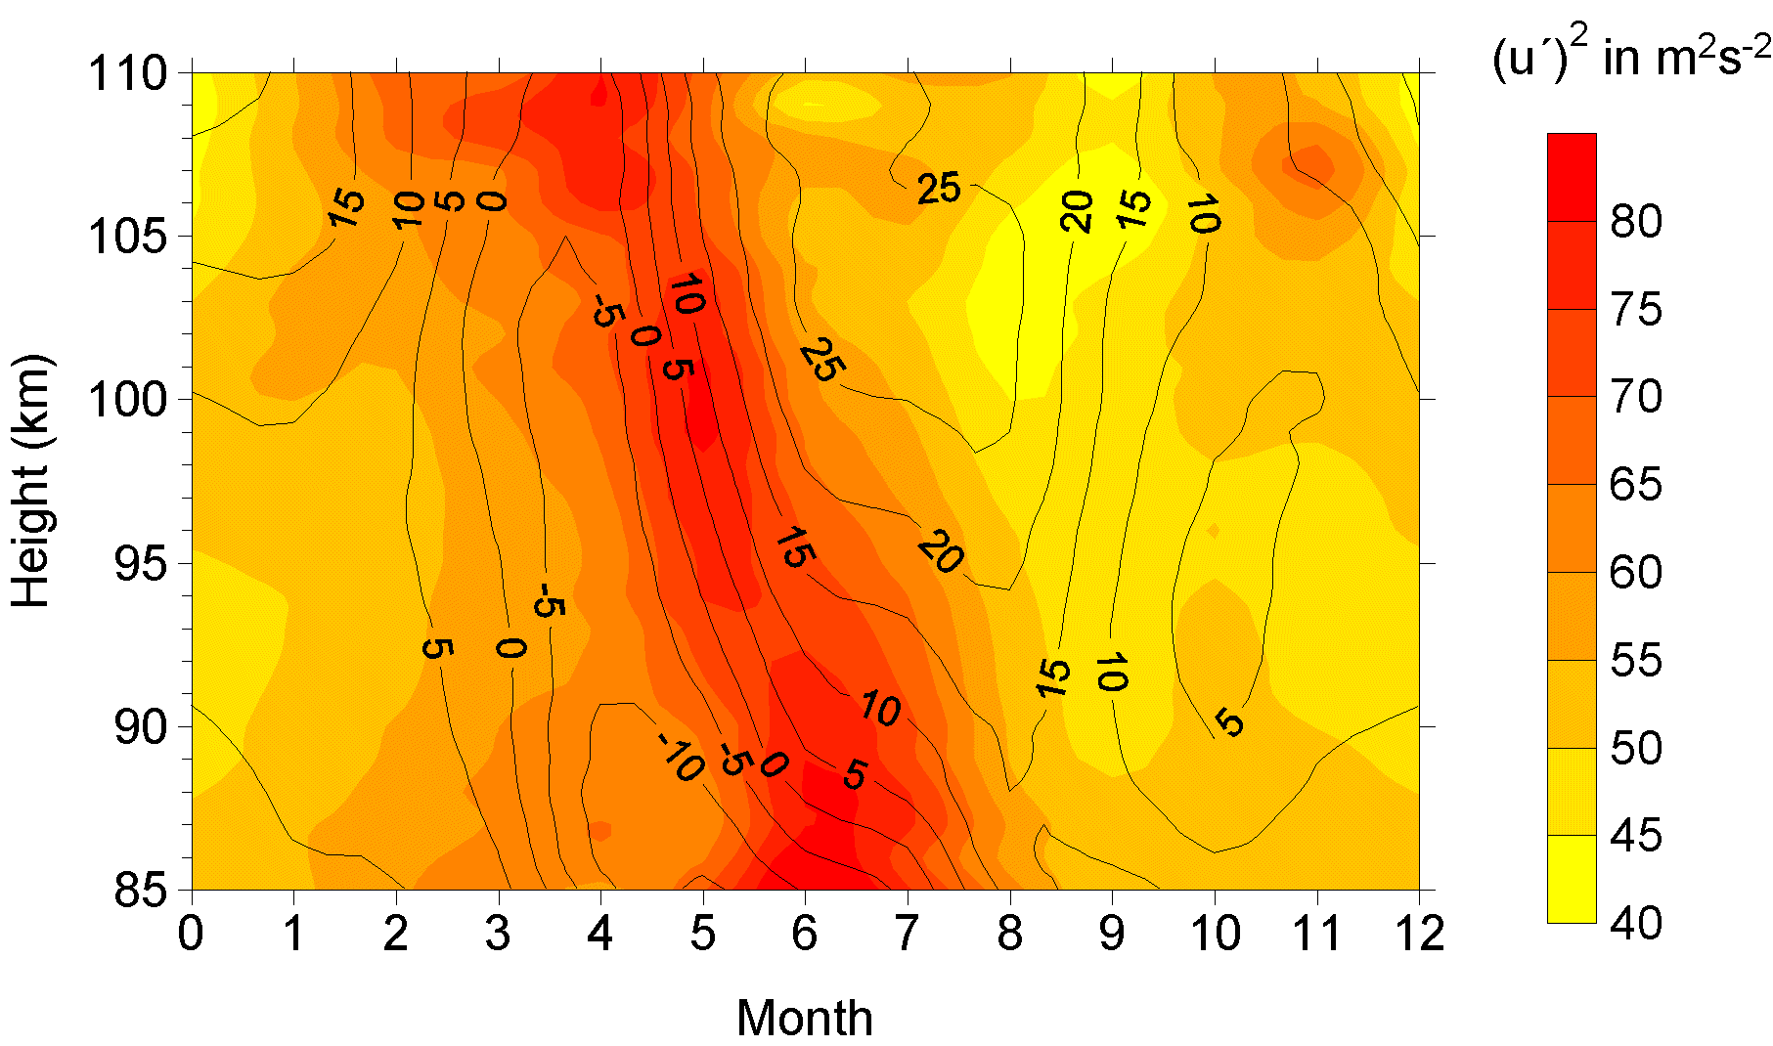
5V: V for Variety
Various formats, types, and structures
Text, numerical, images, audio, video, sequences, time series, social media data, multi-dimensional arrays, etc…
Static data vs. streaming data
A single application can be generating/collecting many types of data
To extract knowledge➔ all these types of data need to be linked together

Slide 14

5V: V for Velocity
Data is being generated fast and need to be processed fast
For time-sensitive processes such as catching fraud, big data must be used as it streams into your enterprise in order to maximize its value
Scrutinize 5 million trade events created each day to identify potential fraud
Analyze 500 million daily call detail records in real-time to predict customer churn faster
Sometimes, 2 minutes is too late!
The latest we have heard is 10 ns (nano seconds) delay is too much

Slide 15
5V: V for Veracity
It refers to the quality and accuracy of data. Gathered data could have missing pieces, may be inaccurate or may not be able to provide real, valuable insight. Veracity, overall, refers to the level of trust there is in the collected data.
Data can sometimes become messy and difficult to use. A large amount of data can cause more confusion than insights if it's incomplete.

Slide 16
5V: V for value
The last V in the 5 V's of big data is value. This refers to the value that big data can provide, and it relates directly to what organizations can do with that collected data. Being able to pull value from big data is a requirement, as the value of big data increases significantly depending on the insights that can be gained from them.
Organizations can use the same big data tools to gather and analyze the data, but how they derive value from that data should be unique to them.

Slide 17
Characteristics of Big data: V5

Slide 18
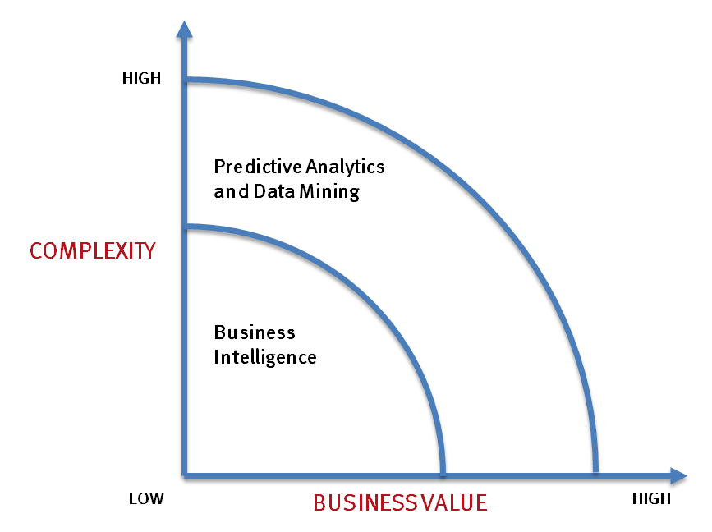
Big data vs. small data
- Optimizations and predictive analytics
- Complex statistical analysis
- All types of data, and many sources
- Very large datasets
- More of a real-time
- Ad-hoc querying and reporting
- Data mining techniques
- Structured data, typical sources
- Small to mid-size datasets

Slide 19
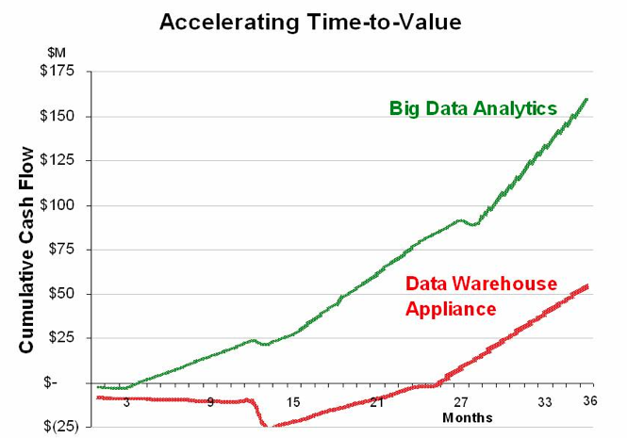
Big data vs. small data
Big data is more real-time in nature than traditional applications
Big data architecture
Traditional architectures are not well-suited for big data applications (e.g. Exa-data, Tera-data)
Massively parallel processing, scale out architectures are well-suited for big data applications

Slide 20
Challenges ahead…
The Bottleneck is in technology
New architecture, algorithms, techniques are needed
Also in technical skills
Experts in using the new technology and dealing with Big data
Who are the major players in the world of Big data?

Slide 21
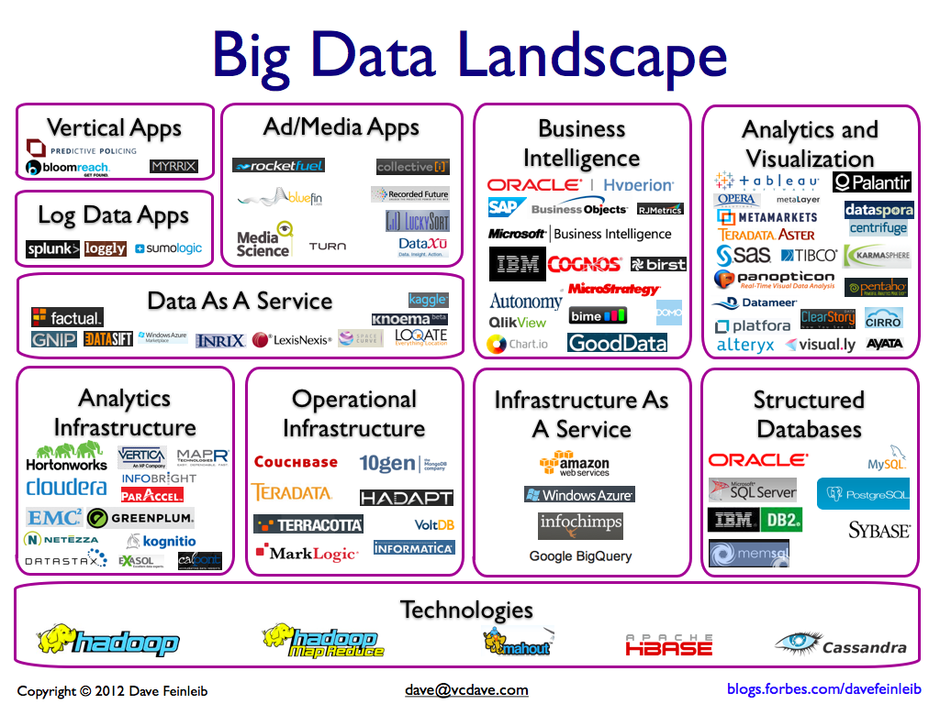
Big data players

Slide 22






Major players…
Google
Hadoop
MapReduce
Mahout
Apache Hbase
Cassandra

Slide 23
Tools available
NoSQL
DatabasesMongoDB, CouchDB, Cassandra, Redis, BigTable, Hbase, Hypertable, Voldemort, Riak, ZooKeeper
MapReduce
Hadoop, Hive, Pig, Cascading, Cascalog, mrjob, Caffeine, S4, MapR, Acunu, Flume, Kafka, Azkaban, Oozie, Greenplum
Storage
S3, HDFS, GDFS
Servers
EC2, Google App Engine, Elastic, Beanstalk, Heroku
Processing
R, Yahoo! Pipes, Mechanical Turk, Solr/Lucene, ElasticSearch, Datameer, BigSheets, Tinkerpop

Slide 24
Any question?

Slide 25
Questions of the day…
What is the smallest and largest units of measuring size of data?
How big a Quintillion measure is?
Give the examples of a smallest the largest entities of data.
Give FIVE parameters with which data can be categorized as i) simple, ii) Moderately complex and iii) complex?

Slide 26
Questions of the day…
What type of data are involved in the following applications?
Weather forecasting
Mobile usage of all customers of a service provider
Anomaly (e.g. fraud) detection in a bank organization
Person categorization, that is, identifying a human
Air traffic control in an airport
Streaming data from all flying aircrafts of Boeing

